Slide 1
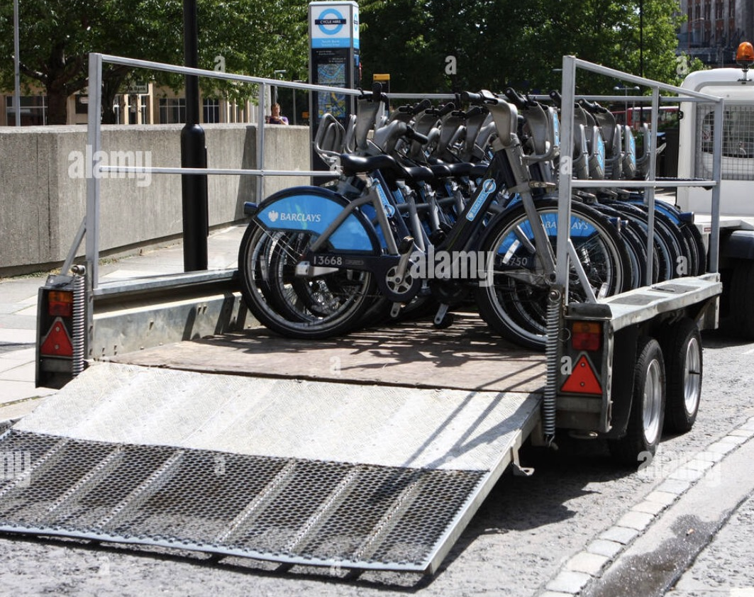
Optimizing
Bike Redistribution for Urban Mobility in Vancouver
Edie Cheng, Mengxu Pan, Jun Tan

Slide 2
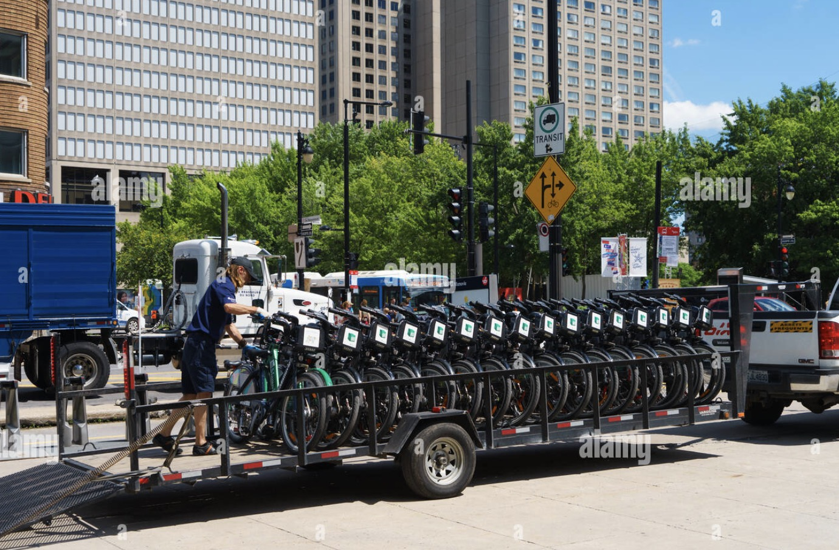
Our problem

Slide 3
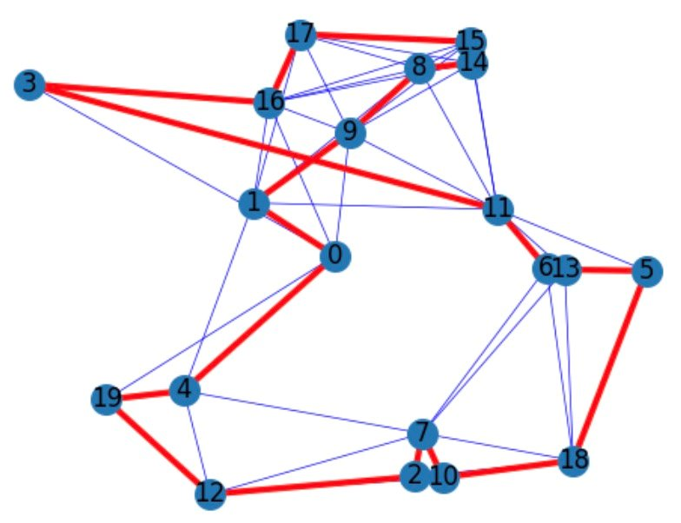
Our Goal:
Find the shortest way to redistribution the bikes
under the constraints

Slide 4
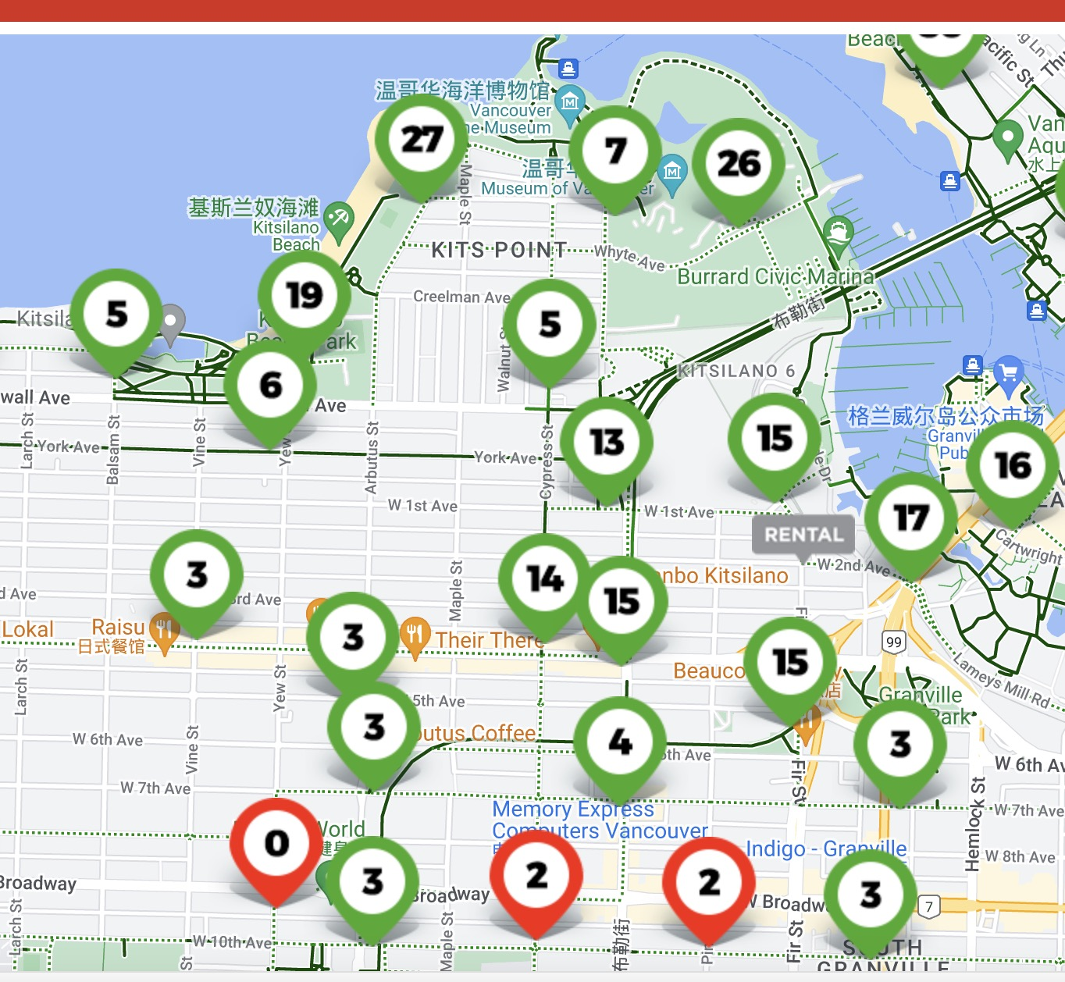
Data Selection
20 stations
from communities such as False Creek, Kitsilano, and Fairview in the western area of Vancouver, which overall can balance themselves.

Slide 5
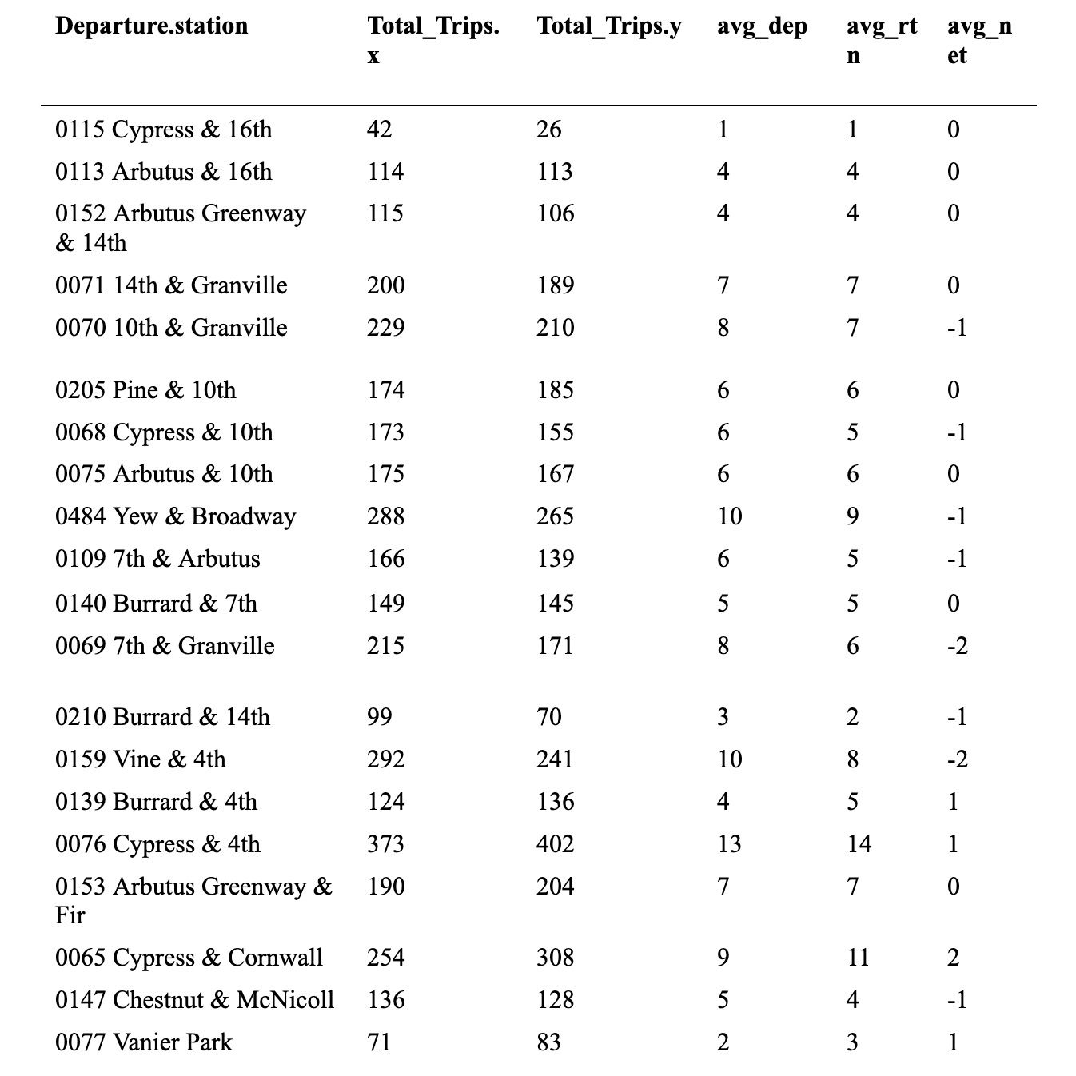
Data Selection
20 stations
which overall can balance themselves.

Slide 6
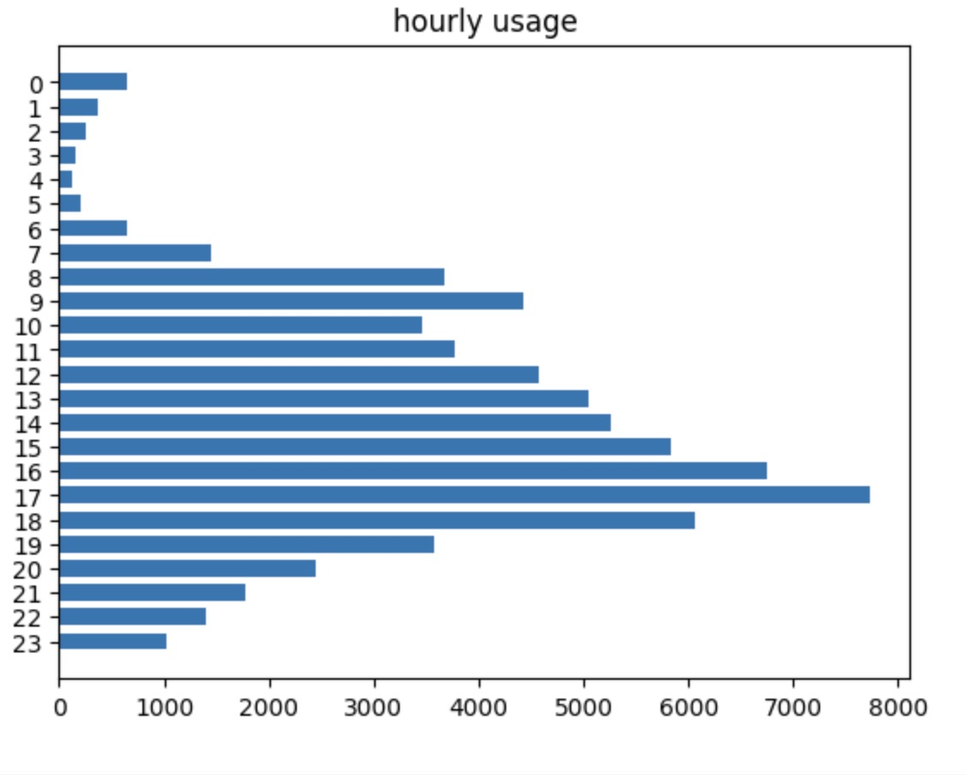
Dataset Description
2.2%
rentals taking place between midnight and 6:00 AM
Hourly trend of bike usage throughout February

Slide 7
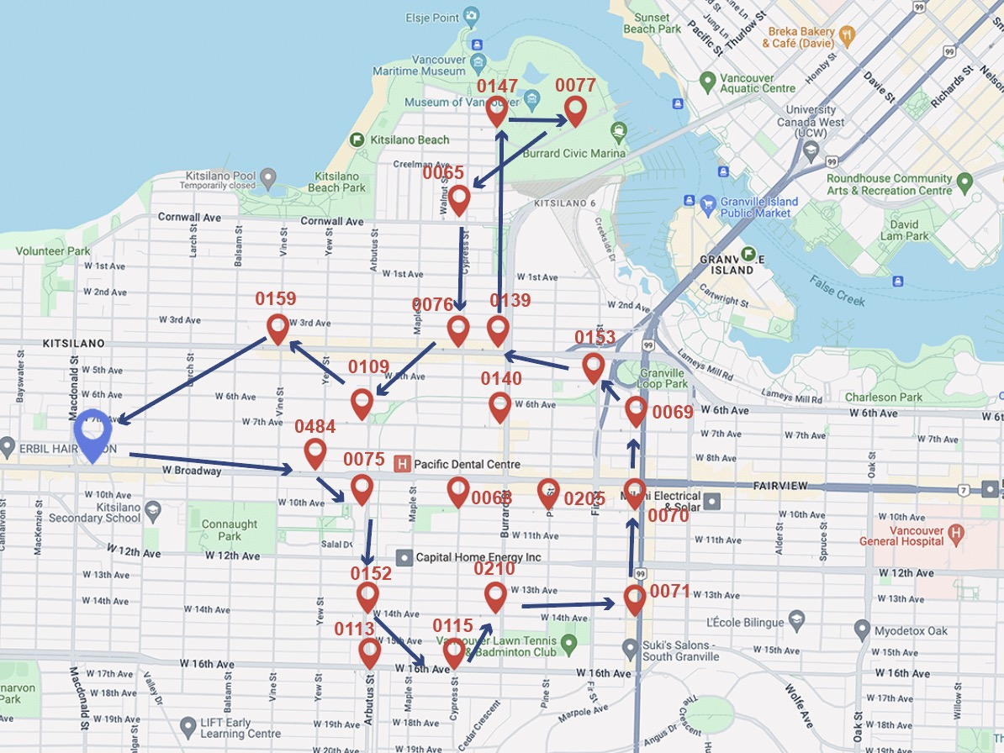
Example of the Repositioning Route
10.3 km
On Feb 12, 2024

Slide 8
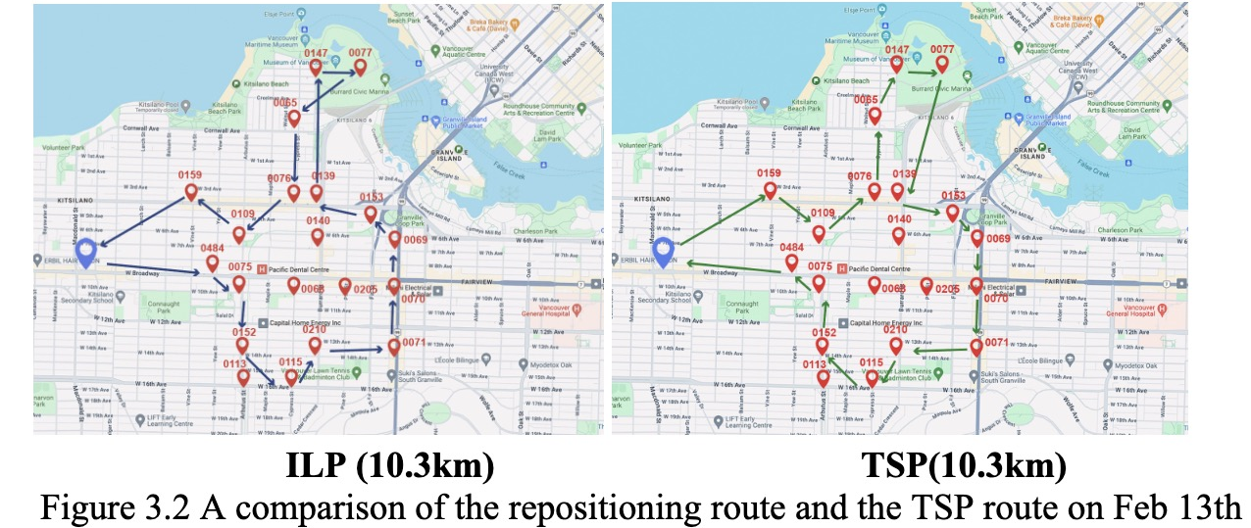
Compared with TSP

Slide 9
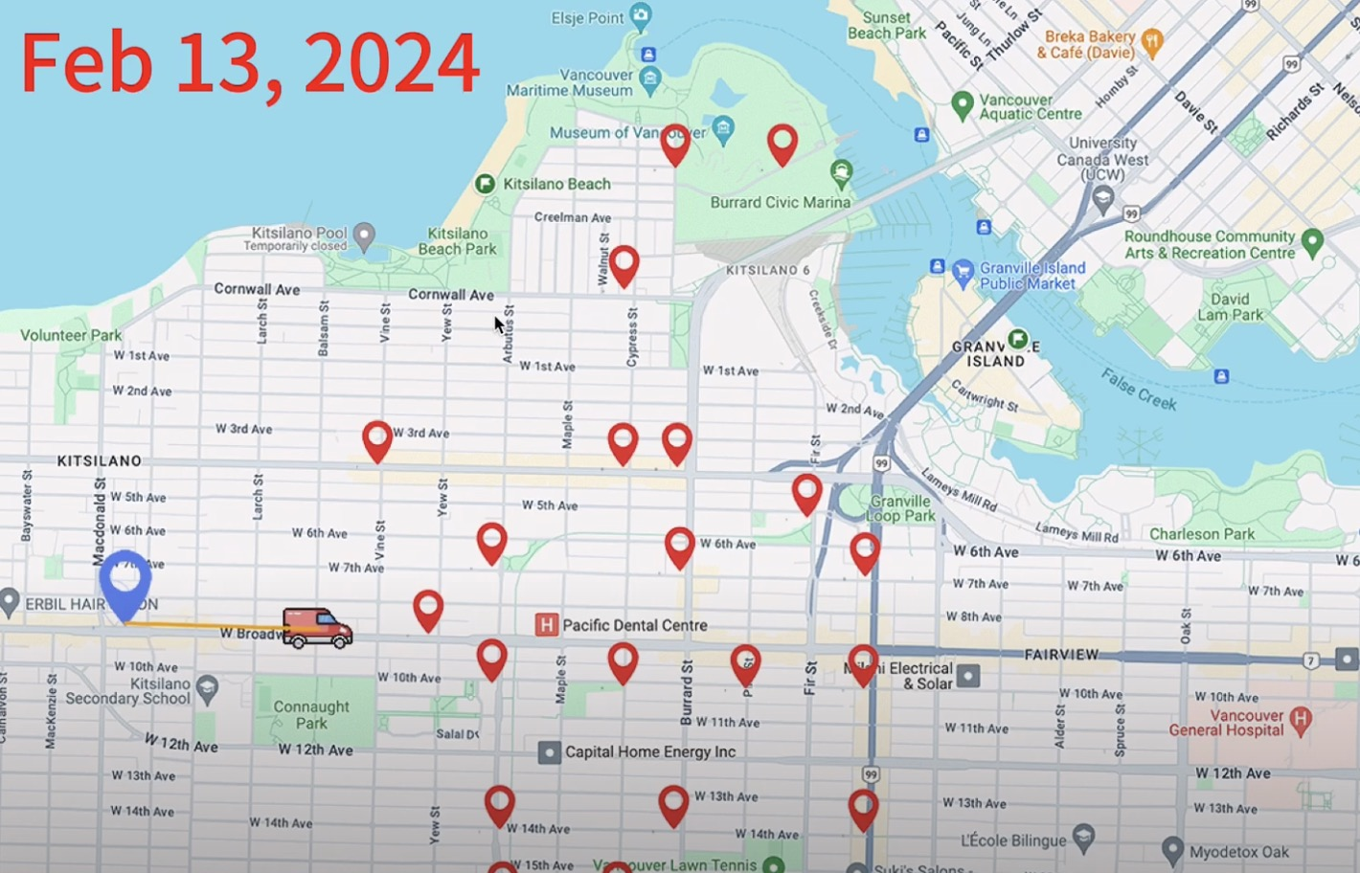
Route in Feb13
https://youtu.be/JDWyKWyV84g

Slide 10




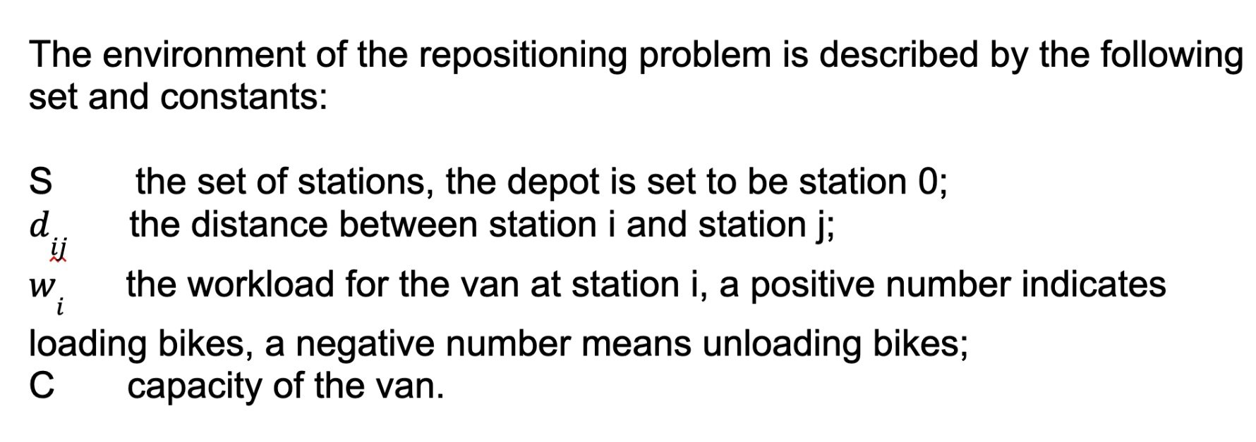
Model Formulation
the workload for the van at station i

Slide 11
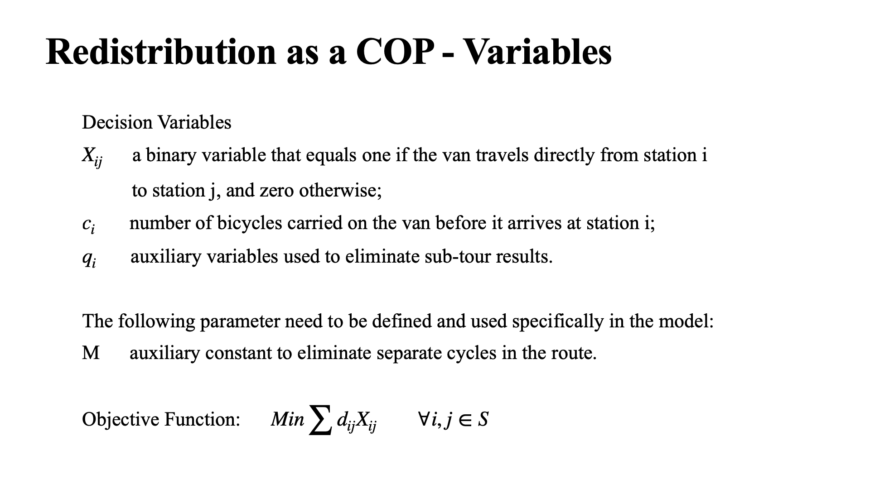

Slide 12
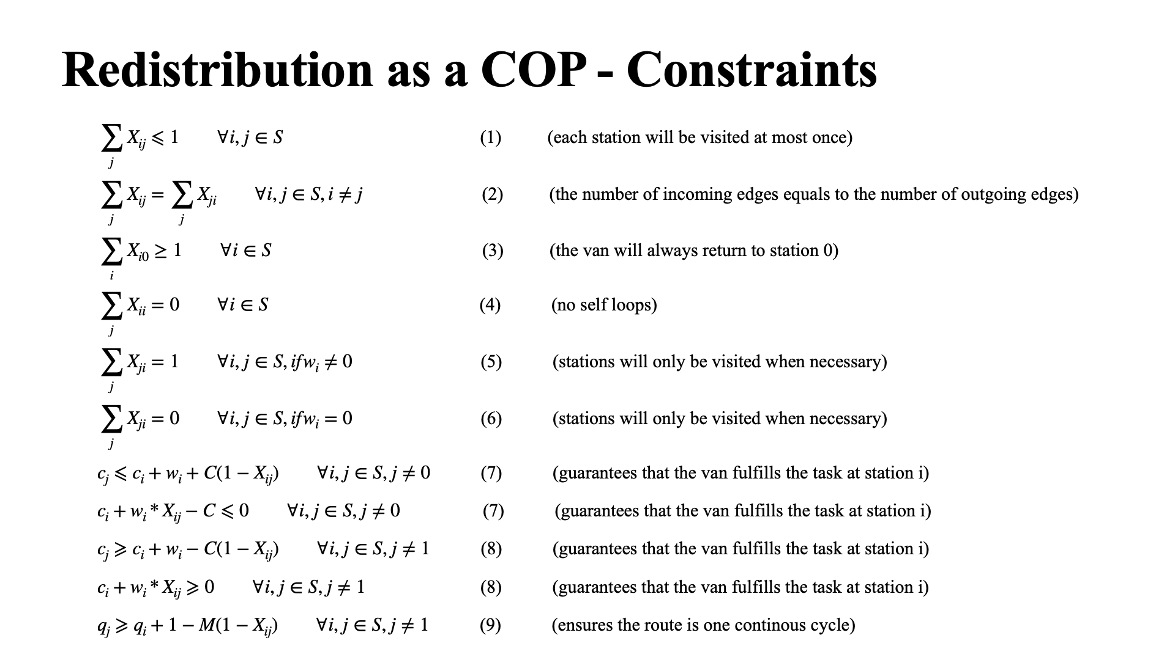

Slide 13
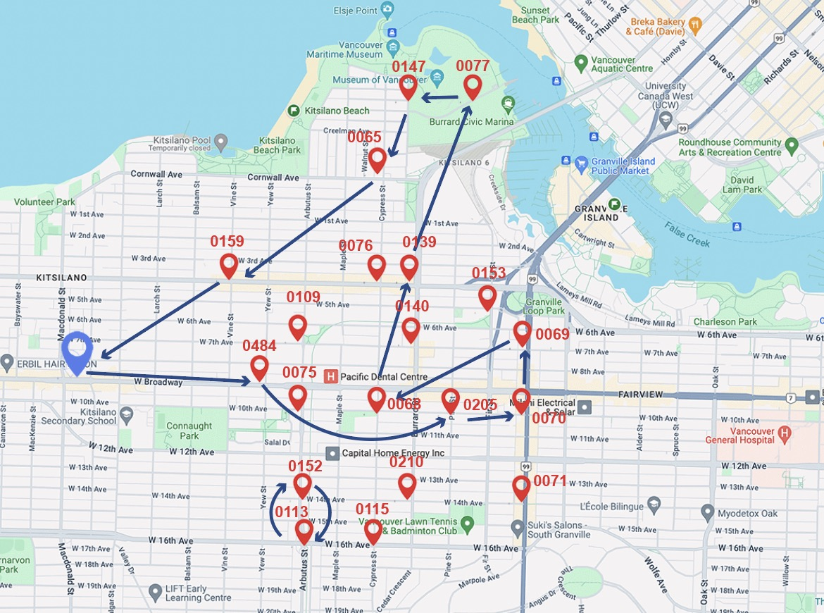
Explanation on Constraint(9)
q[j] >= q(i) + 1 – M(1-X[i, j]), j != 1
Constraints (1) - (8) do not rule out
multiple cycles.
q(j) > q(i) if X[i, j] = 1
Can not generate a cycle without station 0

Slide 14
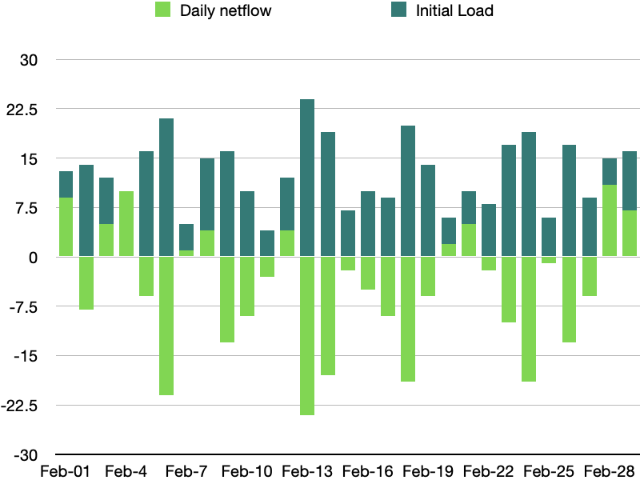
Numerical Analysis
Our model can determine the optimal number of bikes for the van's initial load.

Slide 15
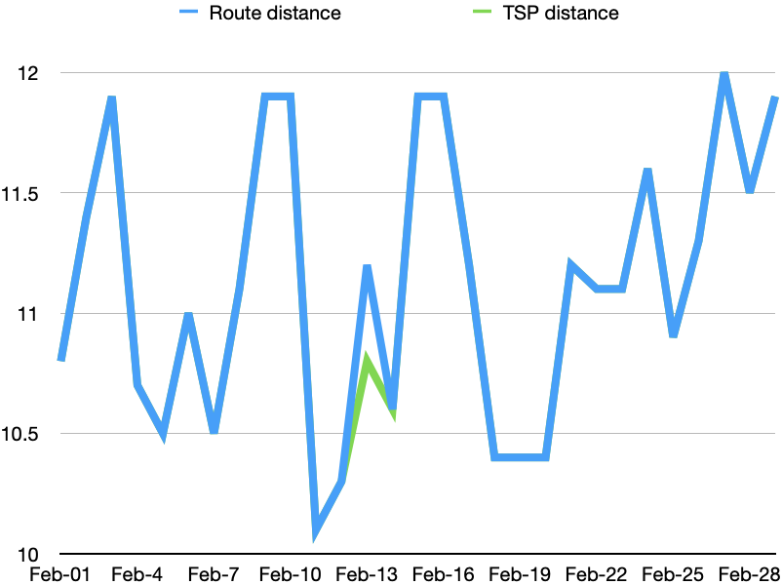
Numerical Analysis
We calculated the TSP distance of all visited stations on each day for comparison.
28 out of 29 days in February, our repositioning route's distance matches the possible shortest distance.

Slide 16
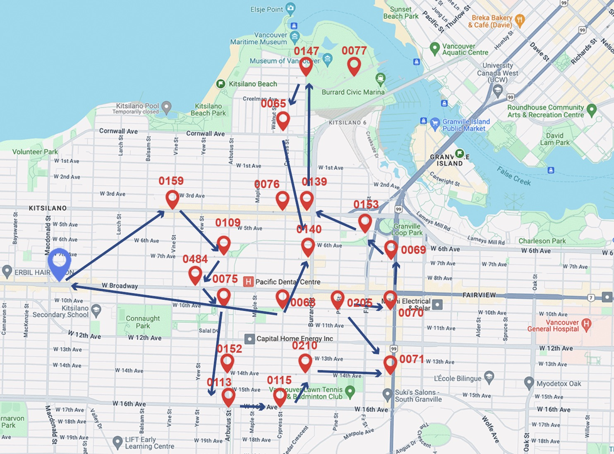
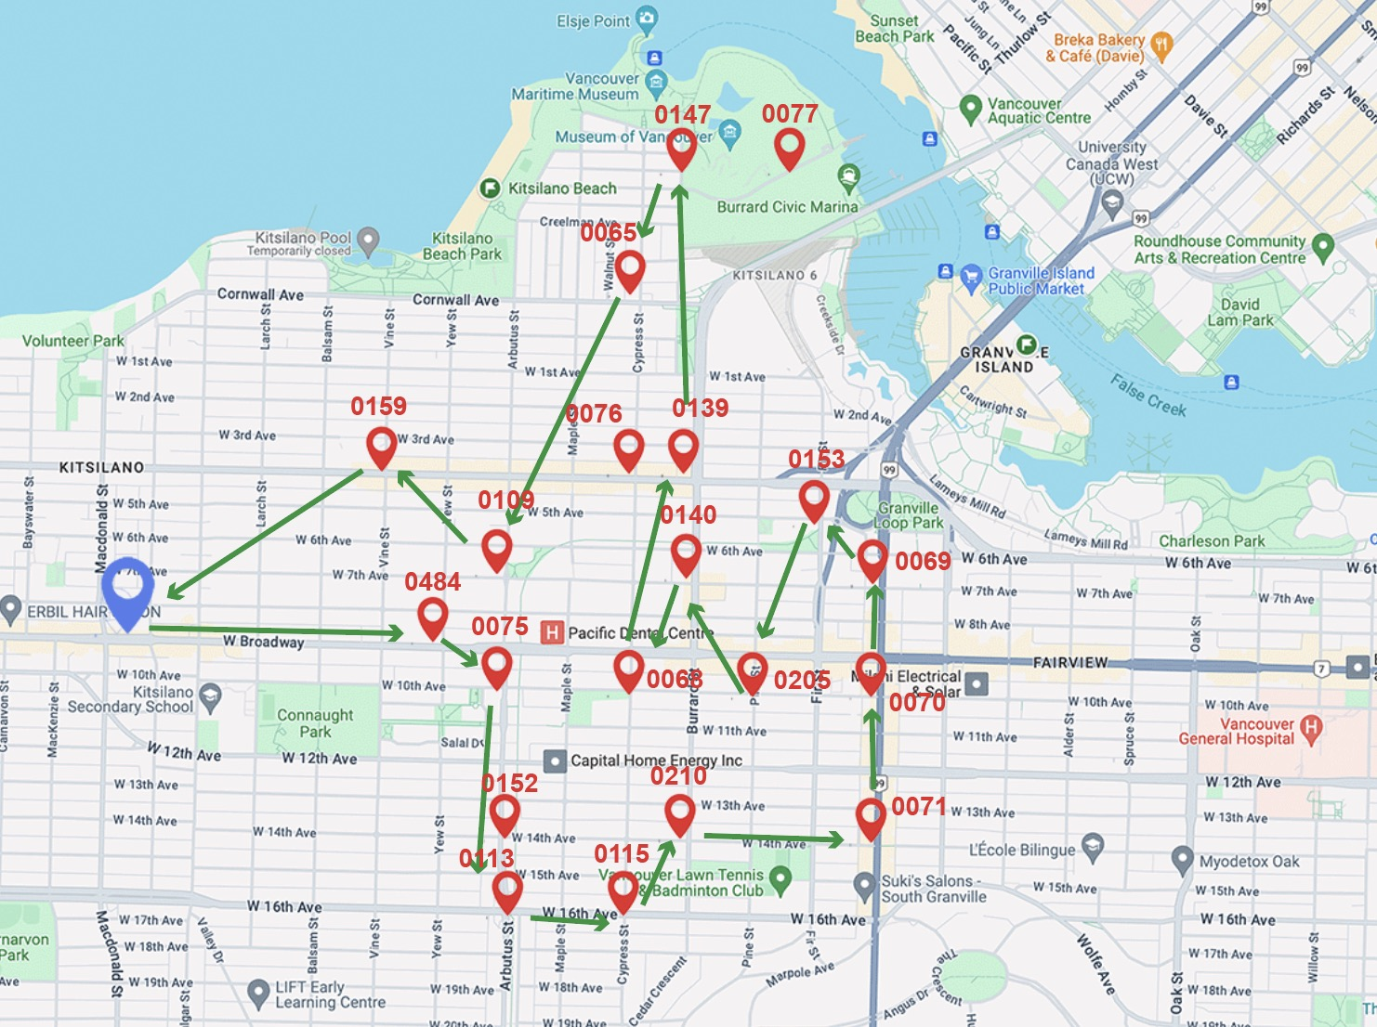
Comparative Analysis of Repositioning Routes and TSP Routes
ILP (11.2km) TSP(10.8km)

Slide 17
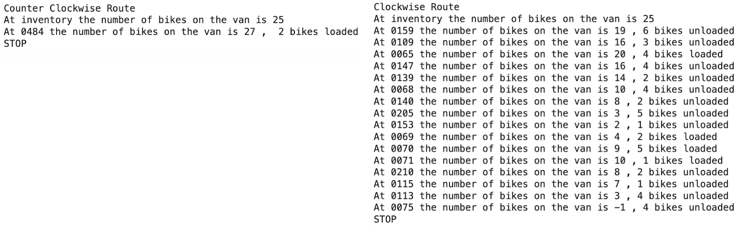
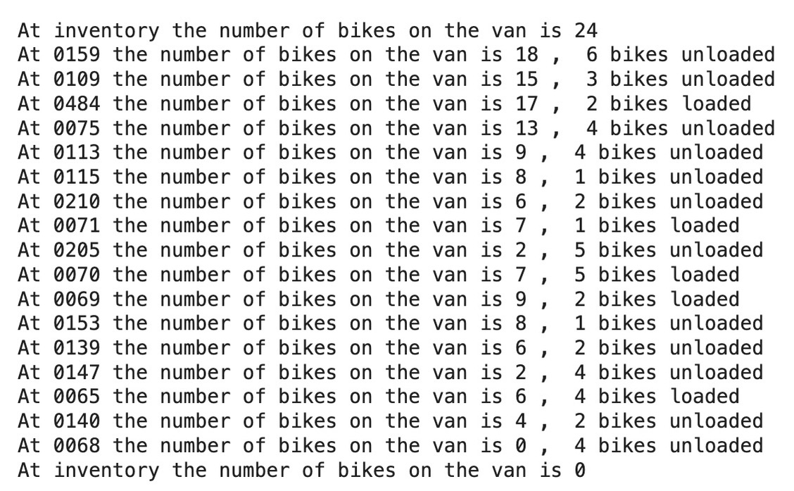
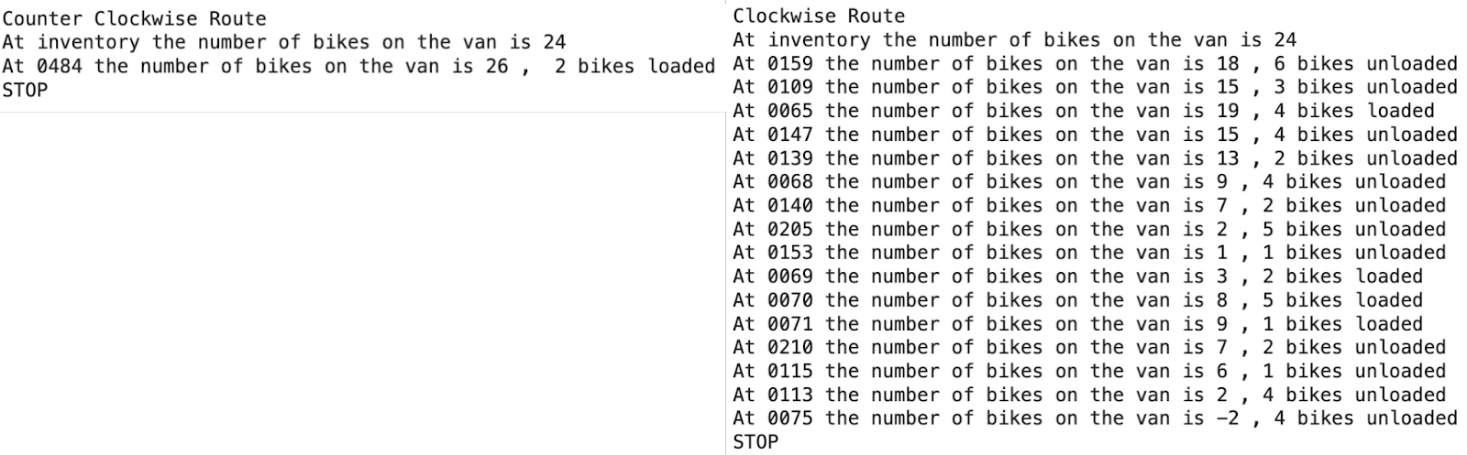
Comparative Analysis of Repositioning Routes and TSP Routes
Testing repositioning on the TSP route on 13th Feb
Testing repositioning on the model's route on 13th Feb

Slide 18
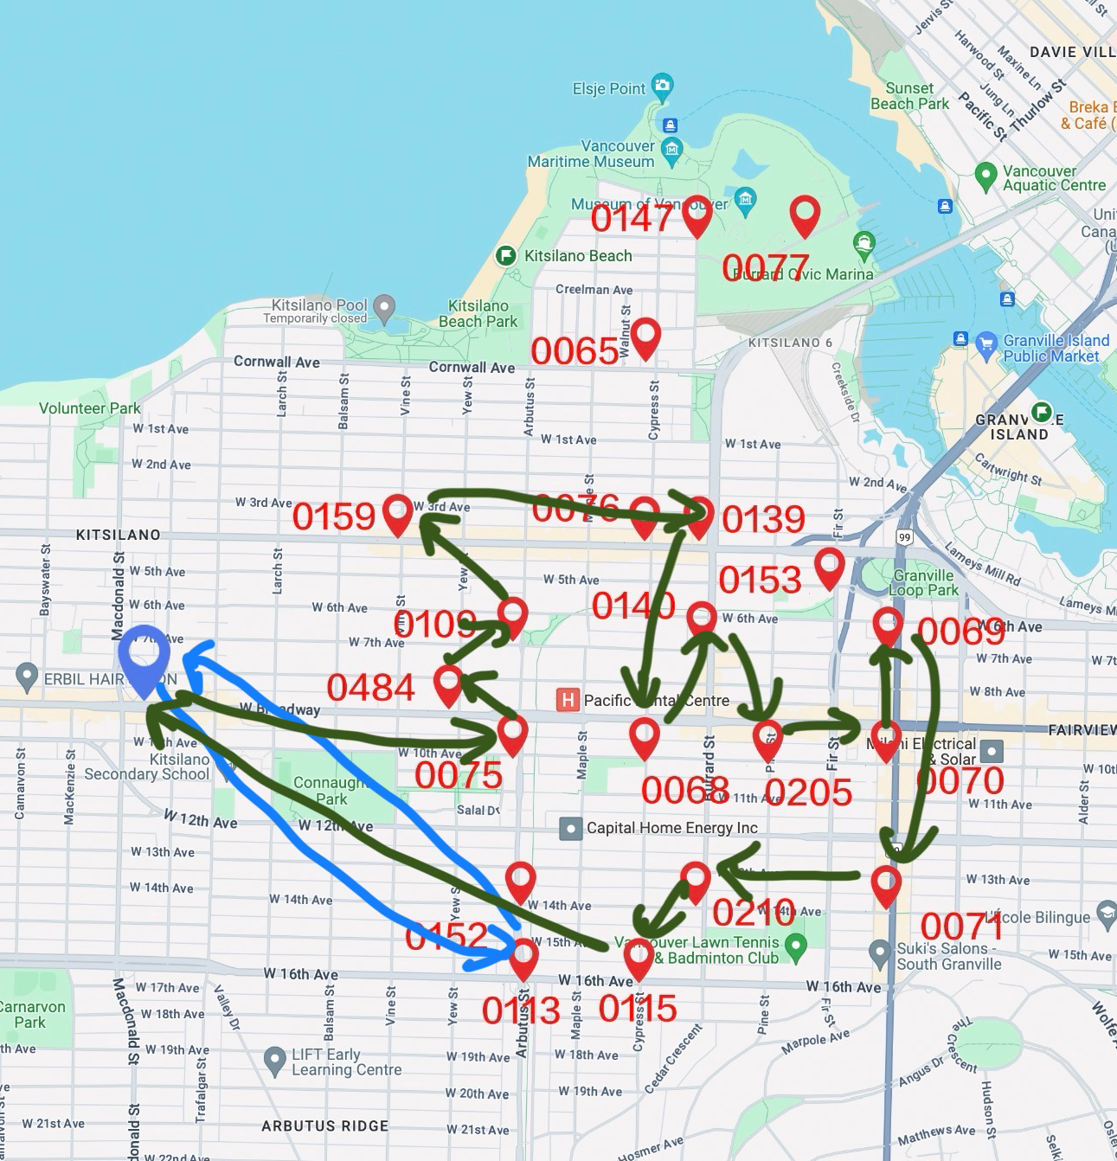
Future works and Discussion- A Multiple-Vans Model
X[i, j, v], c[i, v], q[i, v]
Computation Difficulty
Explore new objective functions

Slide 19
Q&A

